Slide 1
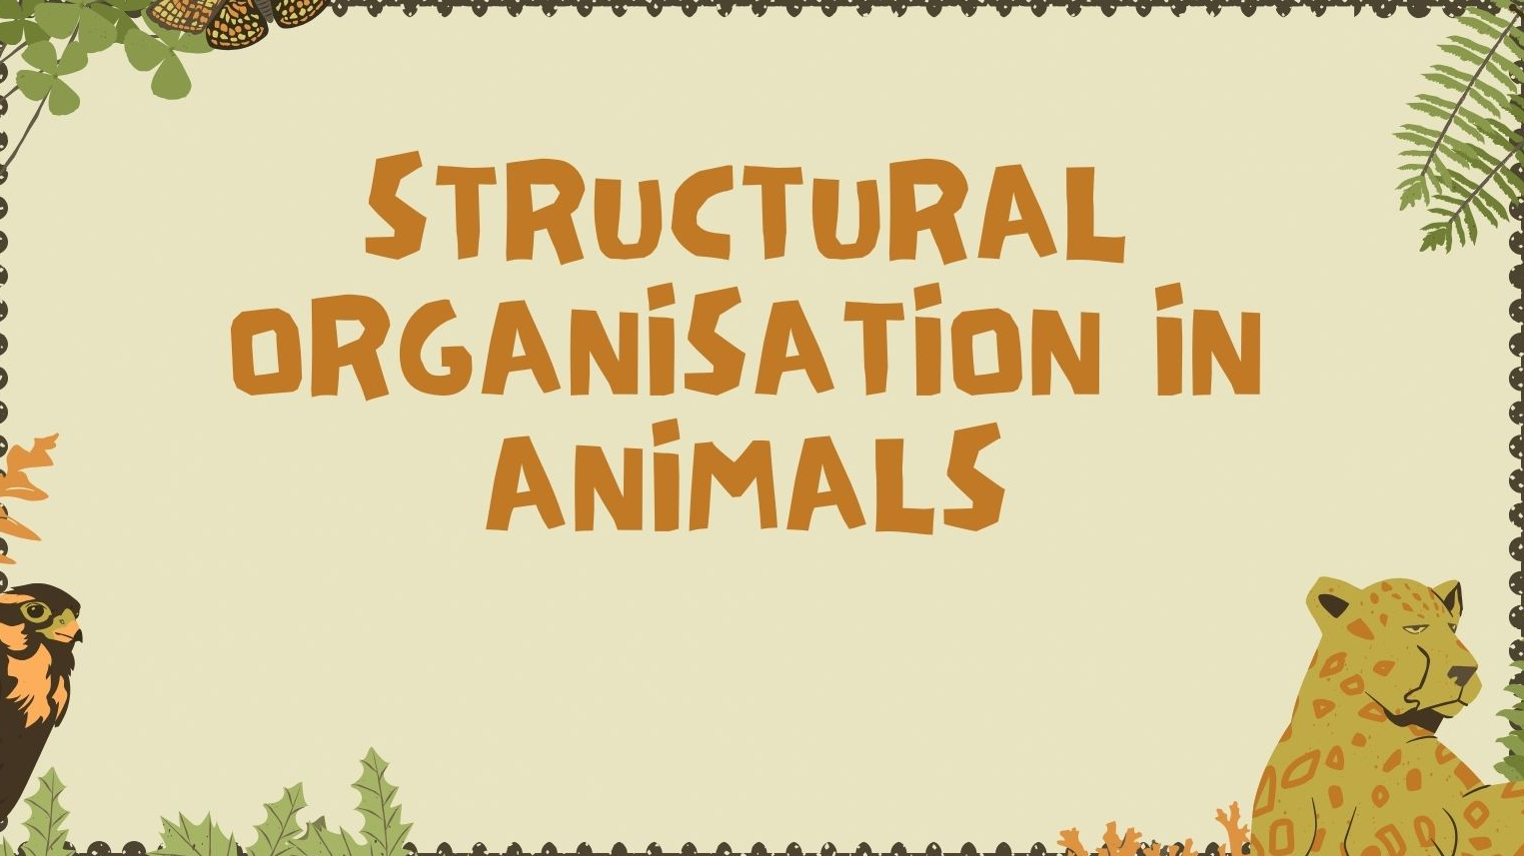

Slide 2
TISSUES
A collection of similar cells and intercellular substances that work together to perform a specific function.

Slide 3
ANIMAL TISSUES
EPITHELIAL TISSUE
MUSCULAR TISSUE
NEURAL TISSUE
CONNECTIVE TISSUE

Slide 4
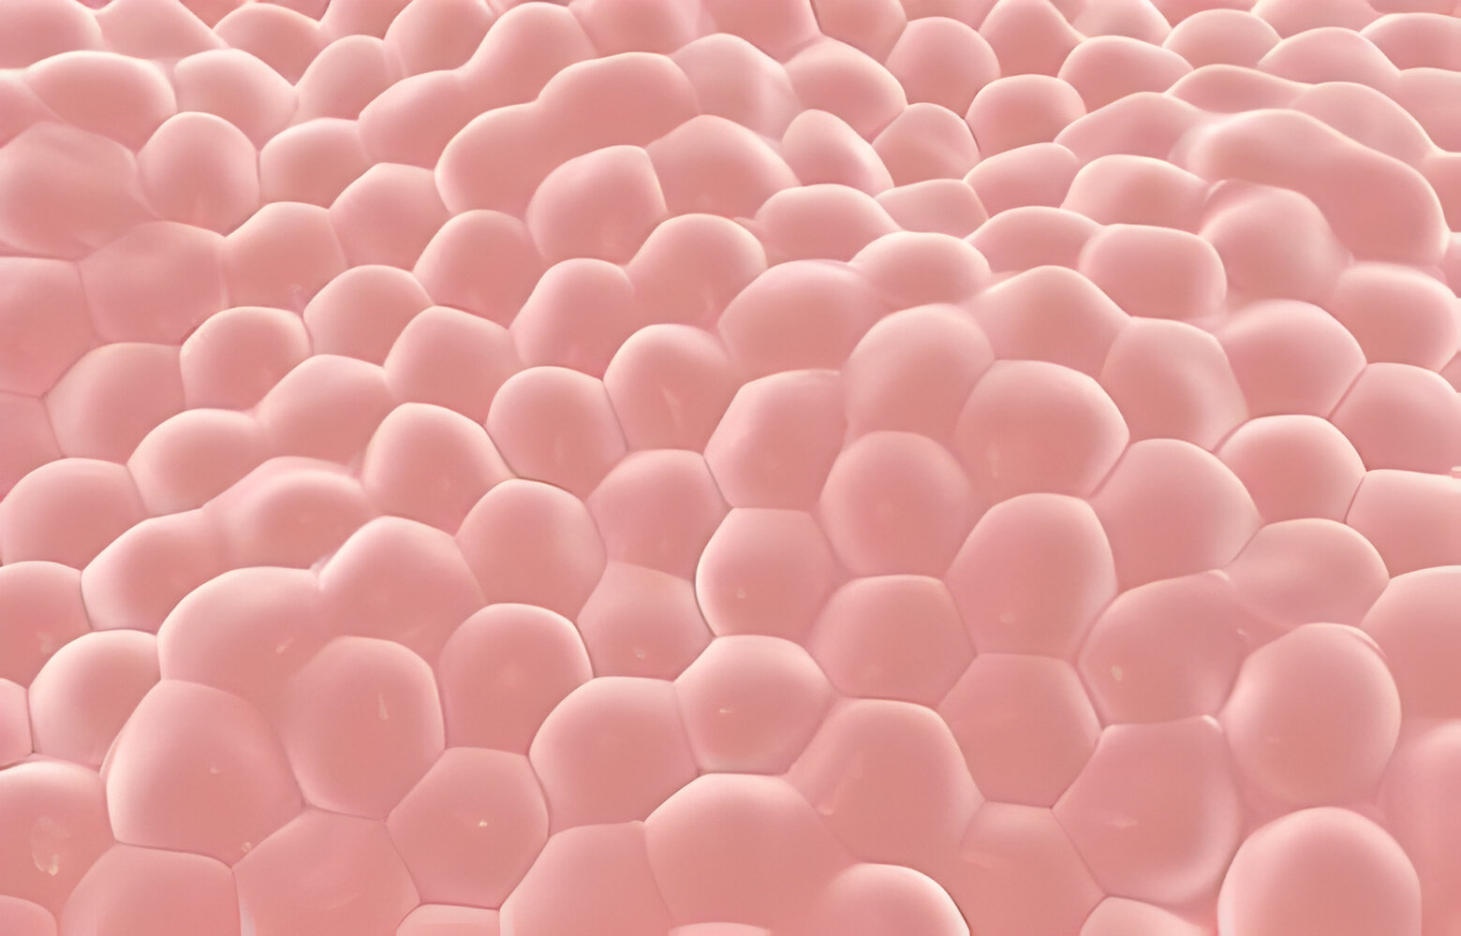
Epithelial Tissues

Slide 5
They are densely packed cells with little intercellular matrix
It covers the surface of the body and lines the internal organs and cavities

Slide 6
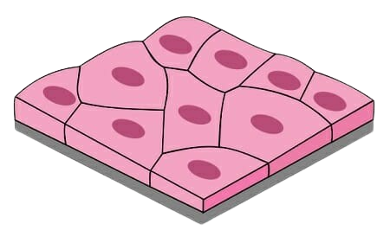
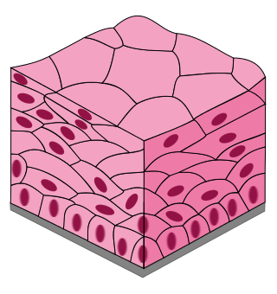
SIMPLE EPITHELIUM
COMPOUND EPITHELIUM

Slide 7
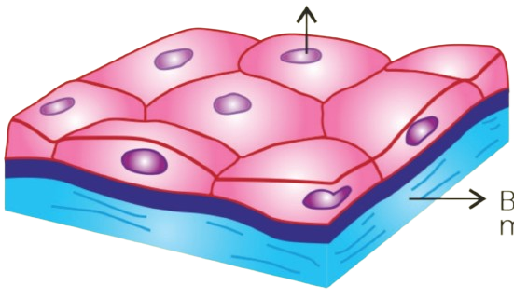
Squamous Epithelium
Nucleus
Basement membrane

Slide 8
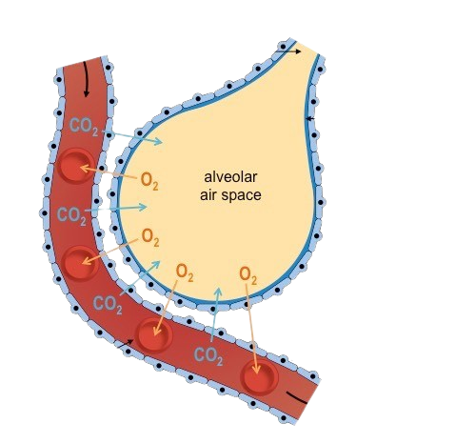

Slide 9
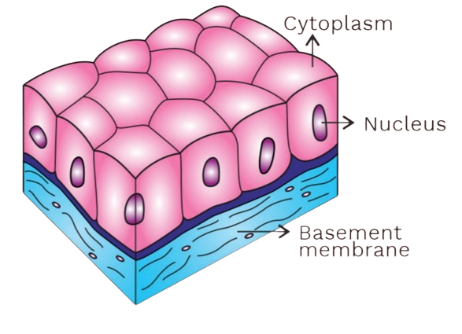
Cuboidal Epithelium

Slide 10
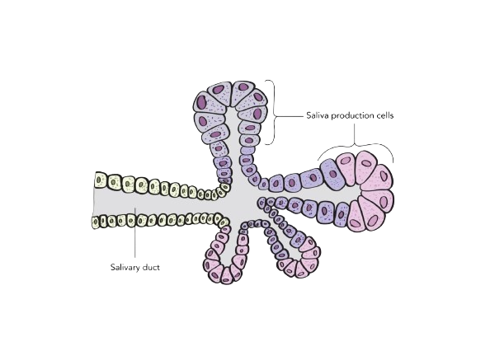
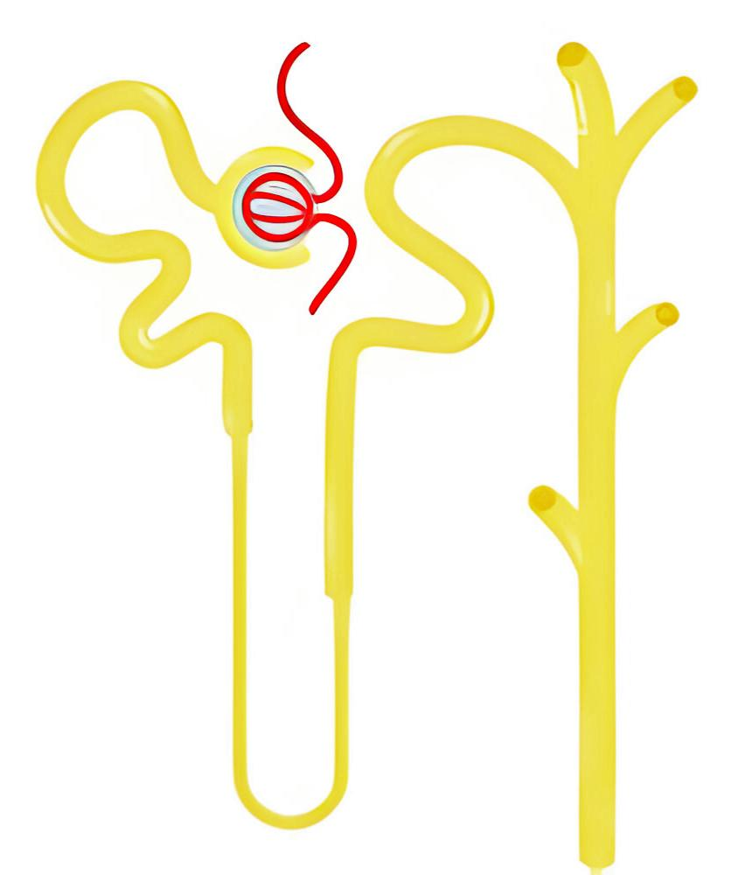

Slide 11
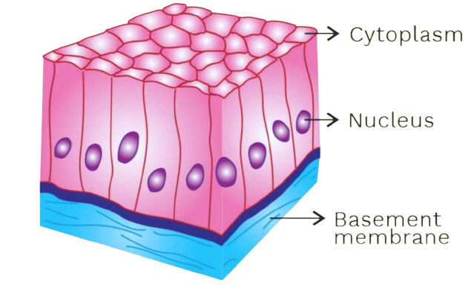
Columnar Epithelium

Slide 12
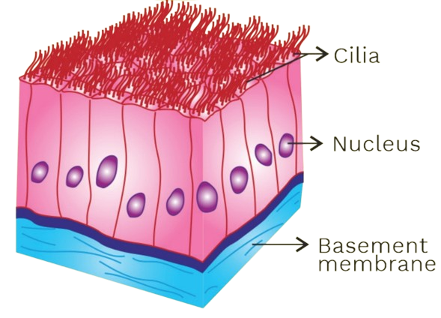
Ciliated Epithelium

Slide 13
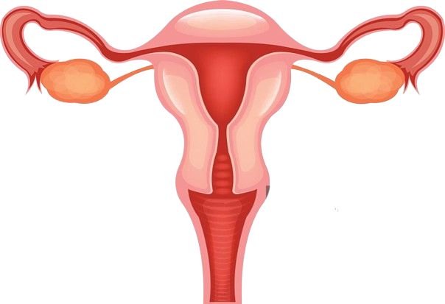

Slide 14
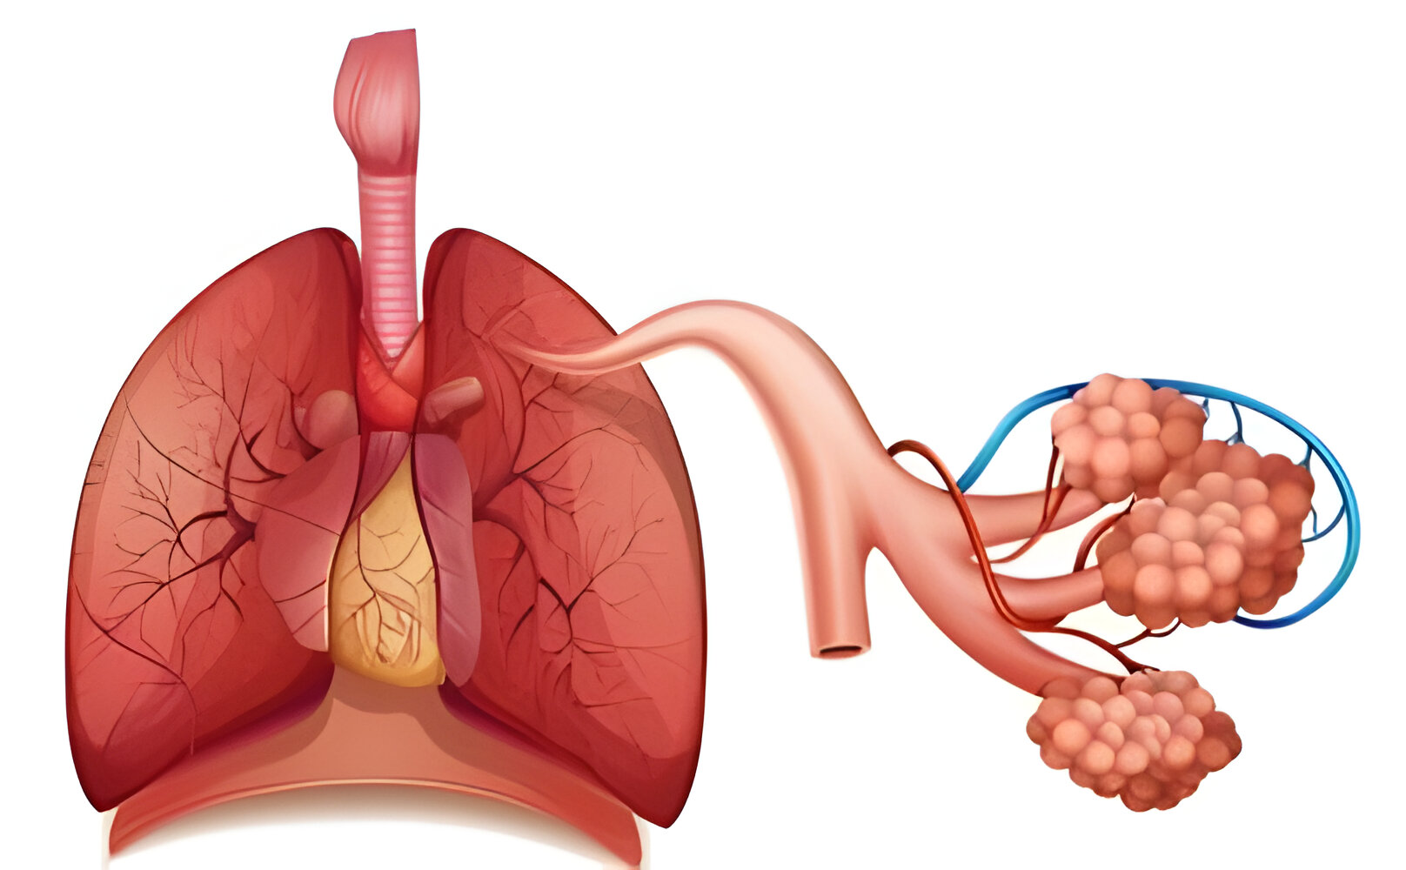

Slide 15
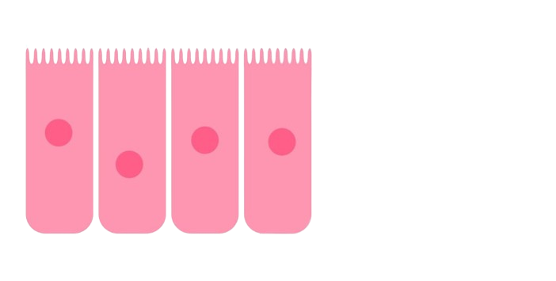
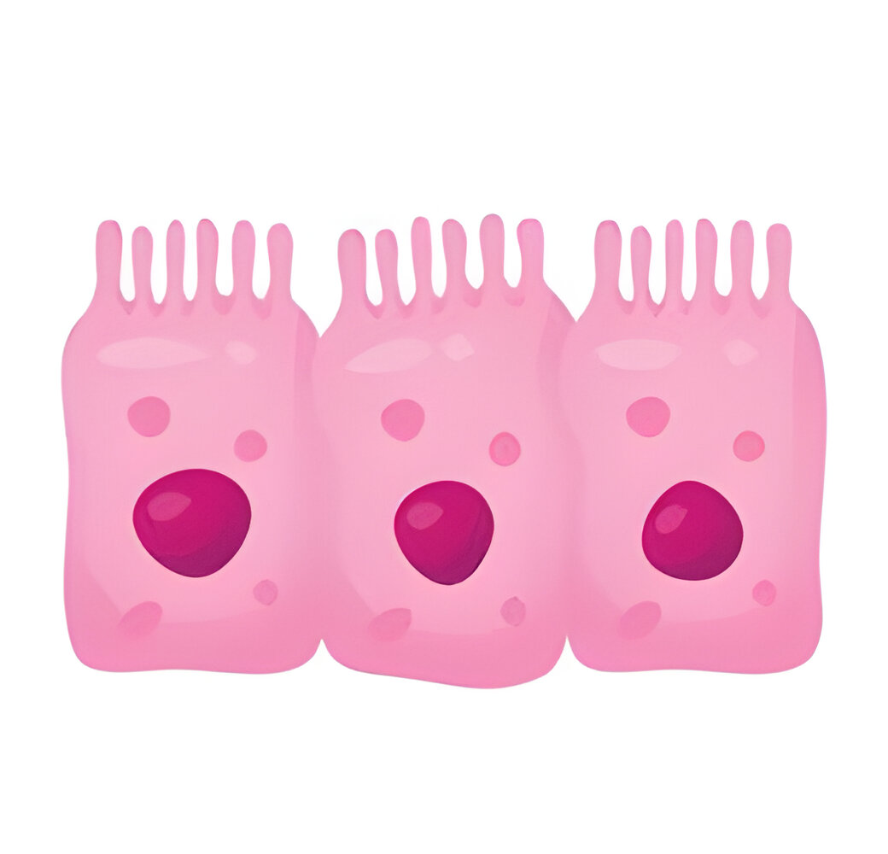
Brush bordered epithelium

Slide 16
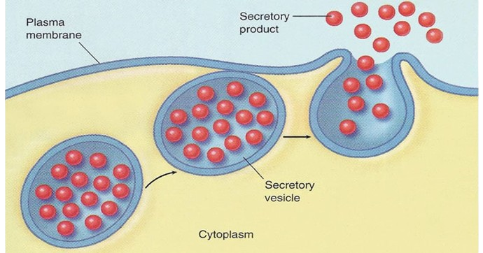
Glandular Epithelium
Cells that have been modified to secrete

Slide 17
Unicellular
They are single, isolated glandular cells
goblet cells in the alimentary canal.

Slide 18
Multicellular
They are a group of glandular cells,

Slide 19
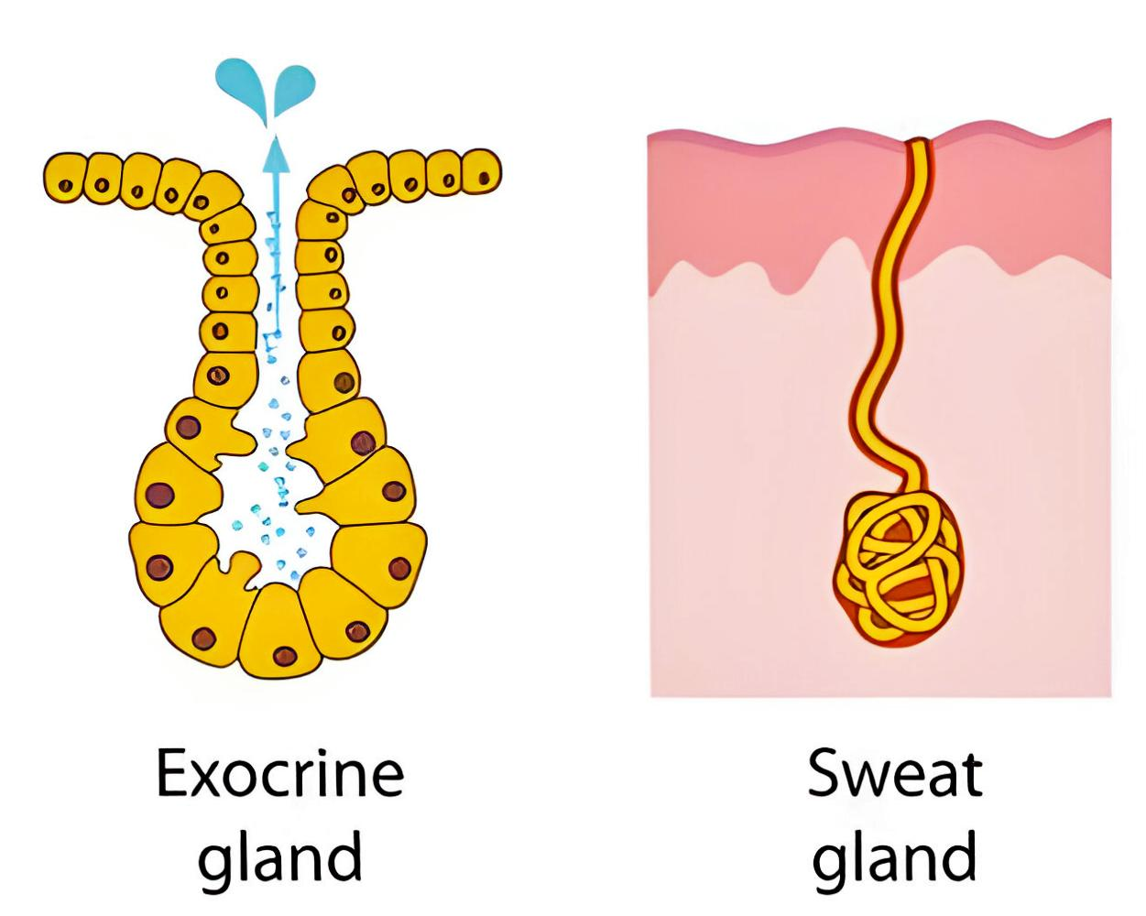
Exocrine glands
glands secrete substances through ducts or tubes

Slide 20
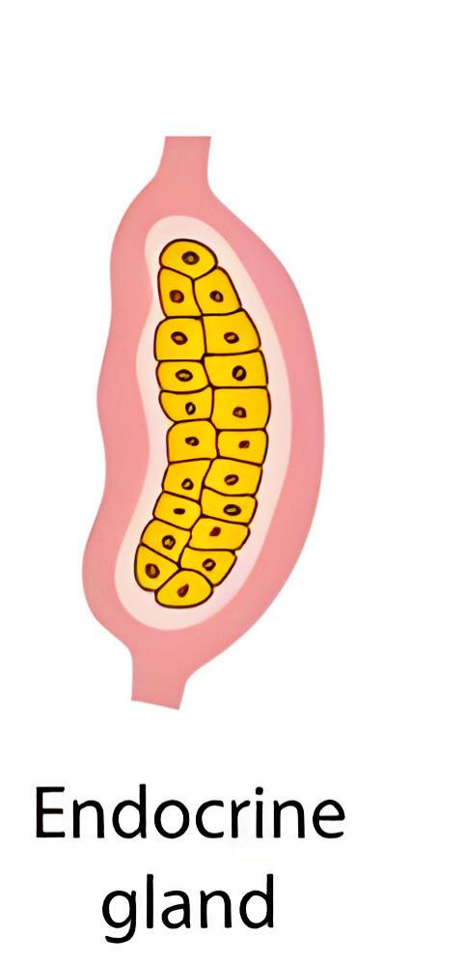
Endocrine Gland
They are devoid of ducts (ductless glands)
Their products are known as hormones, and they are directly secreted into the fluid that surrounds the gland.

Slide 21
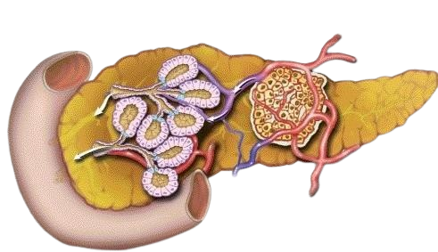
Heterocrine gland

Slide 22
Compound Epithelium
They are multi-layered
limited role in secretion and absorption
They primarily serve to protect against mechanical and chemical stresses

Slide 23
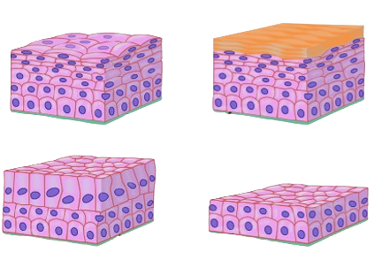
Dry surface of the skin,
The moist surface of the buccal cavity

Slide 24
The inner lining of salivary gland ducts and Pancreatic ducts

Slide 25
CELL JUNCTION
They are specialised structures that connect individual cells structurally and functionally

Slide 26
Tight junctions
prevent substances from leaking across a tissue.

Slide 27
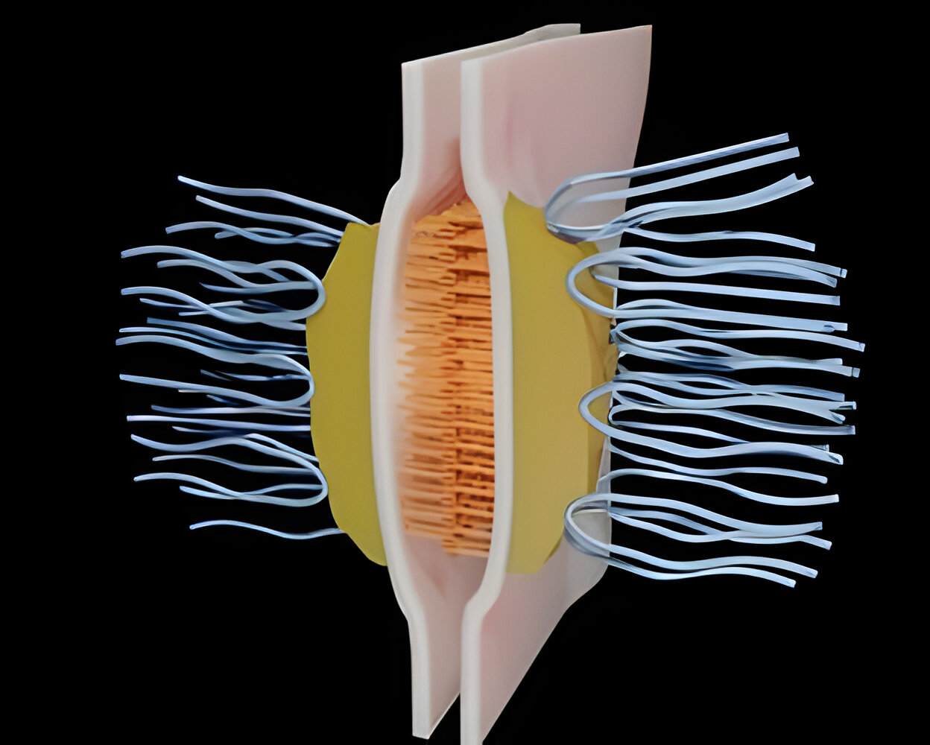
Adhering junctions
connects neighbouring cells.

Slide 28
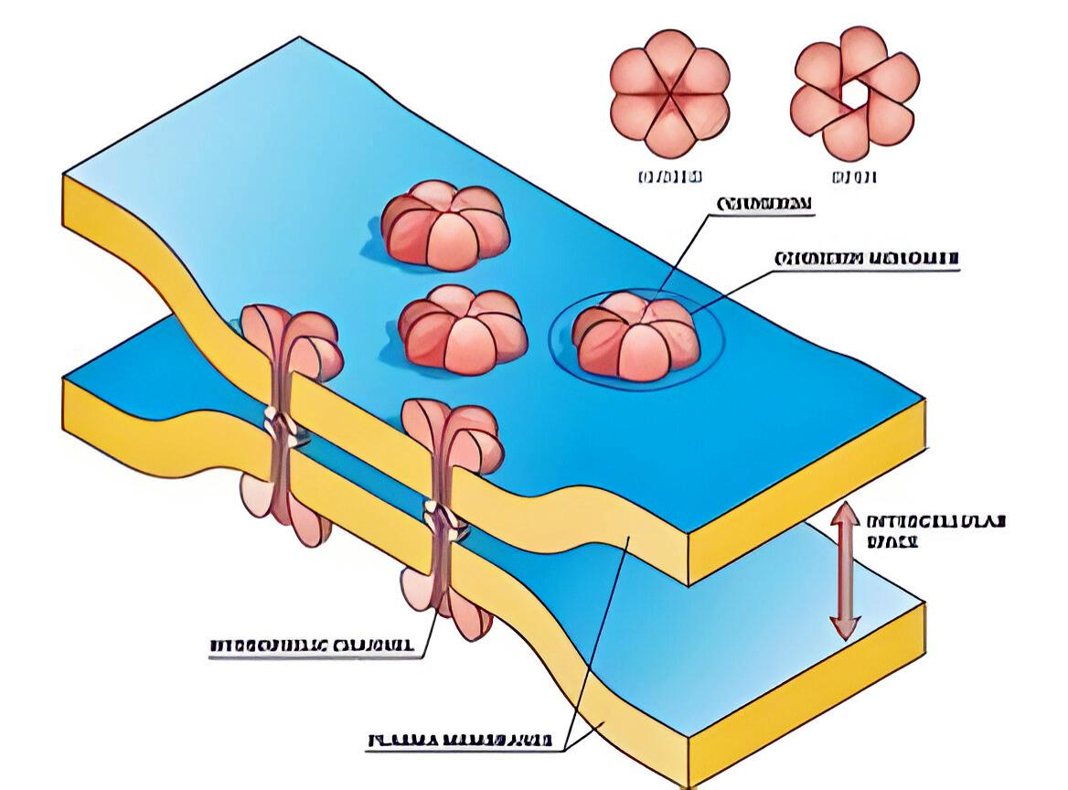
Gap Junctions
They connect the cytoplasm of neighbouring cells, allowing for the rapid transfer of ions, small molecules, and large molecules

Slide 29
CONNECTIVE TISSUE

Slide 30
linking and supporting of body tissues/organs.
Cells in all connective tissues, except blood, secrete structural proteins called collagen or elastin
Cells in all connective tissues, except blood, secrete structural proteins called collagen or elastin

Slide 31
Loose connective tissue

Slide 32
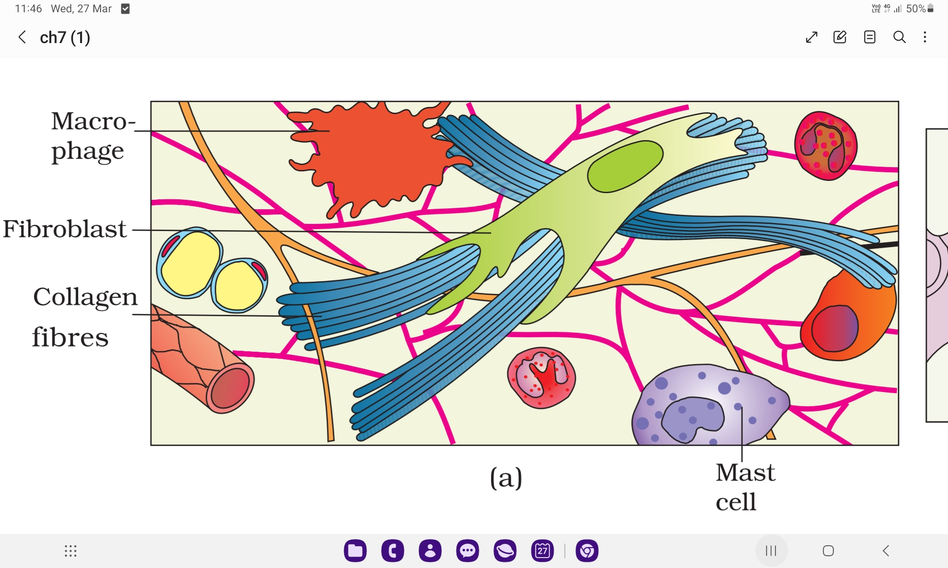
Areolar Tissue
support framework for epithelium.

Slide 33
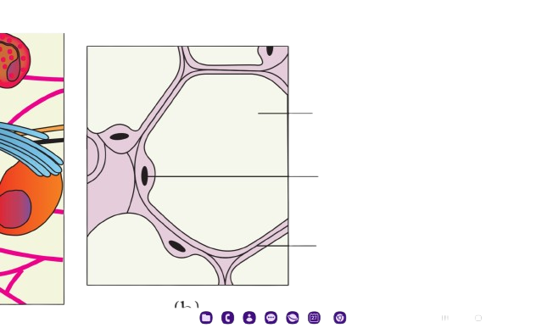
Adipose Tissue
Designed to store fat

Slide 34
Dense Connective Tissue
Cells, fibres, and fibroblasts are arranged in a compact manner with little matrix

Slide 35
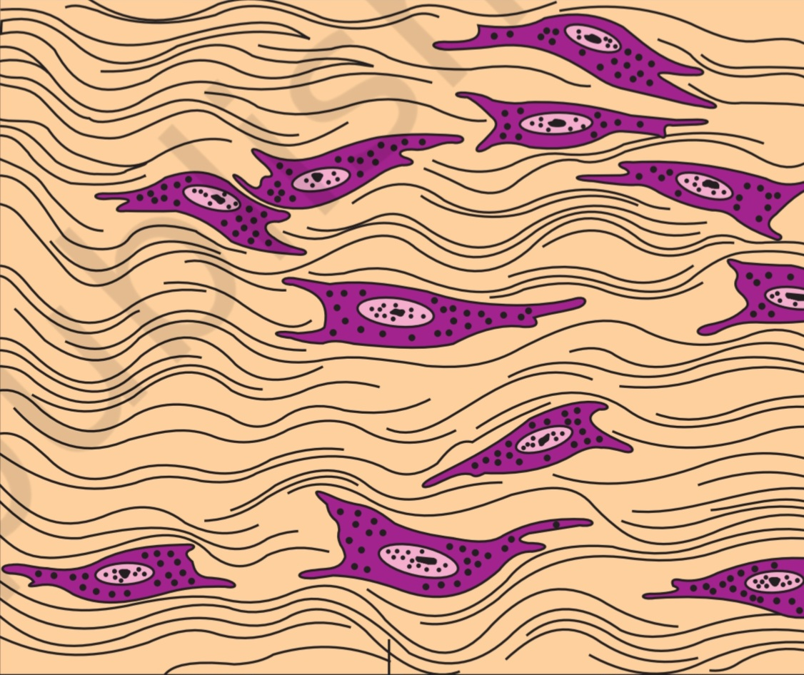
Dense Regular connective

Slide 36
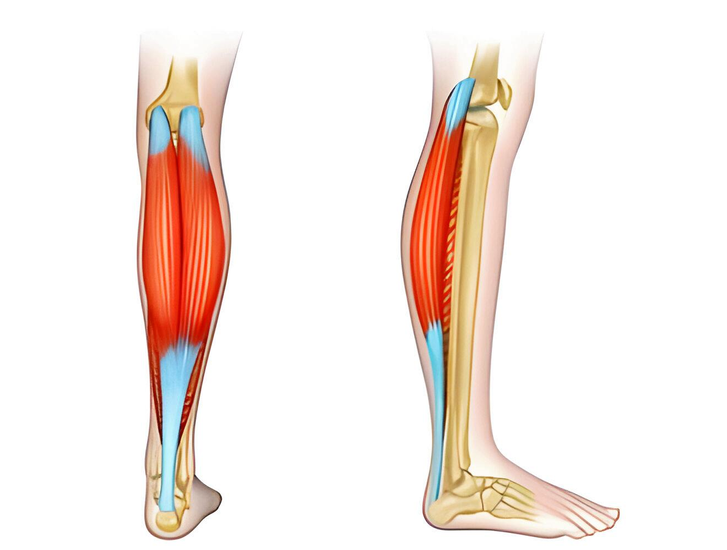
TENDONS

Slide 37
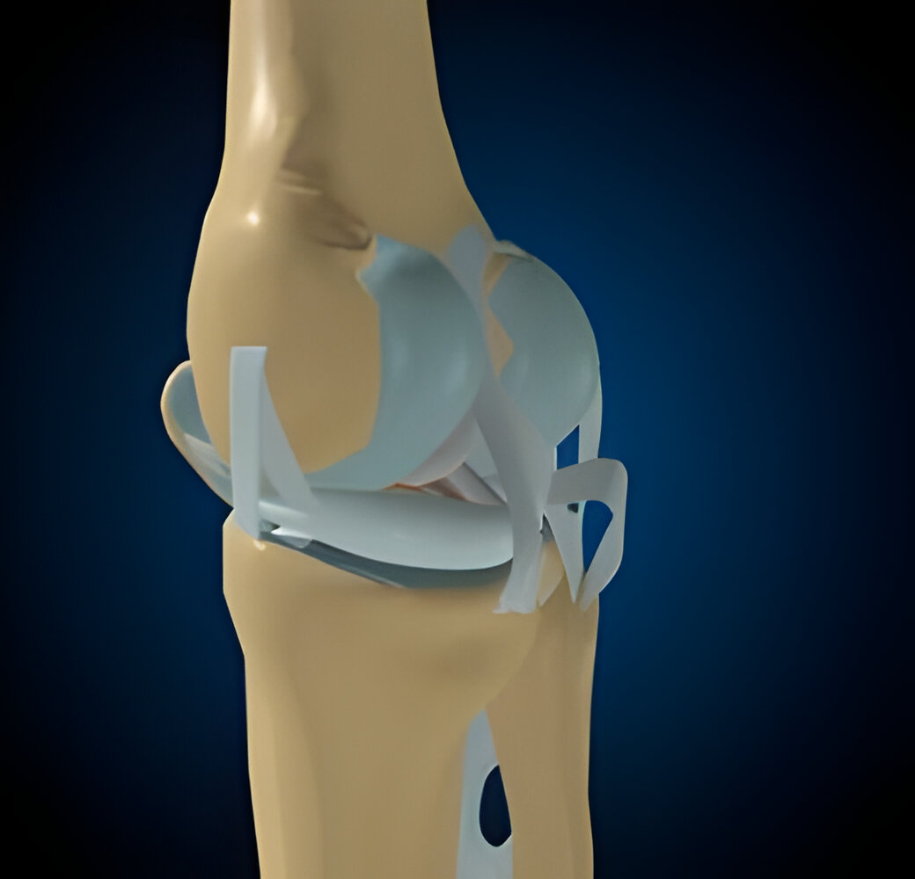
LIGEMENTS

Slide 38
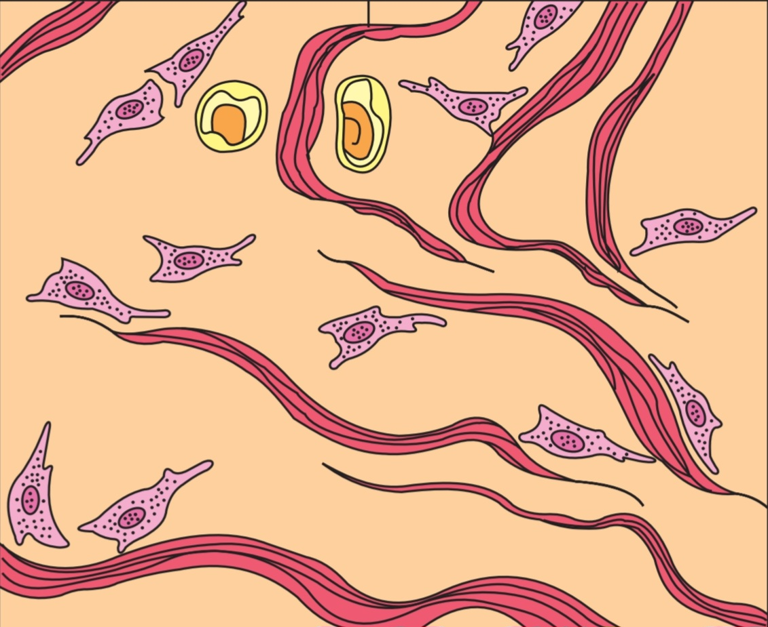
Dense irregular connective tissue

Slide 39
Specialised Connective Tissue
connective tissue that has been trained to perform a specific function.
CARTILAGE
BONE
BLOOD

Slide 40
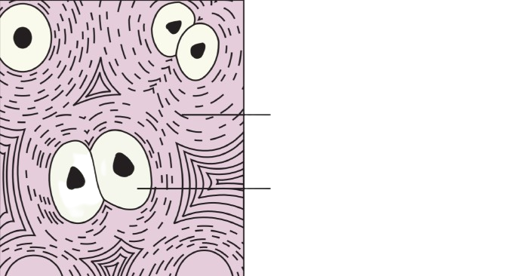
Cartilage
solid and pliable, and it can withstand compression.

Slide 41
BONE
Hard, and non-pliable

Slide 42
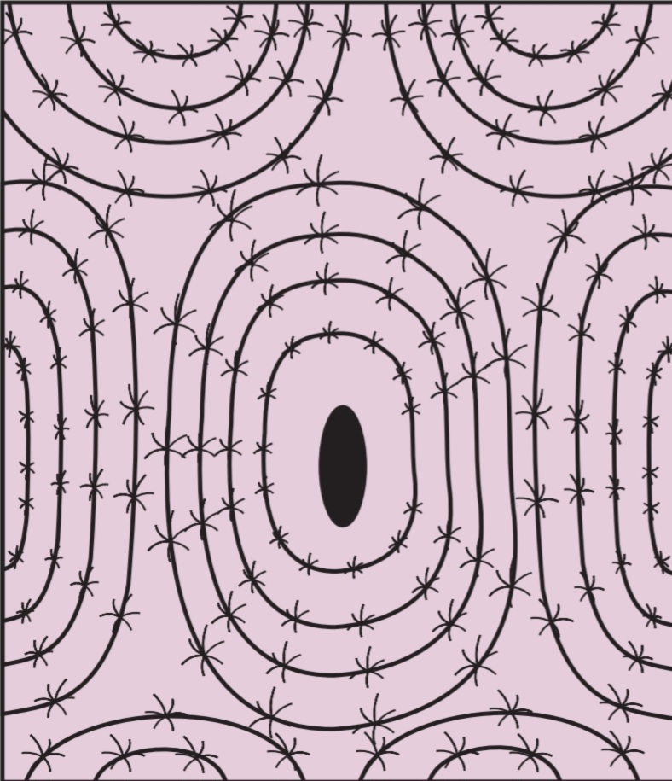

Slide 43
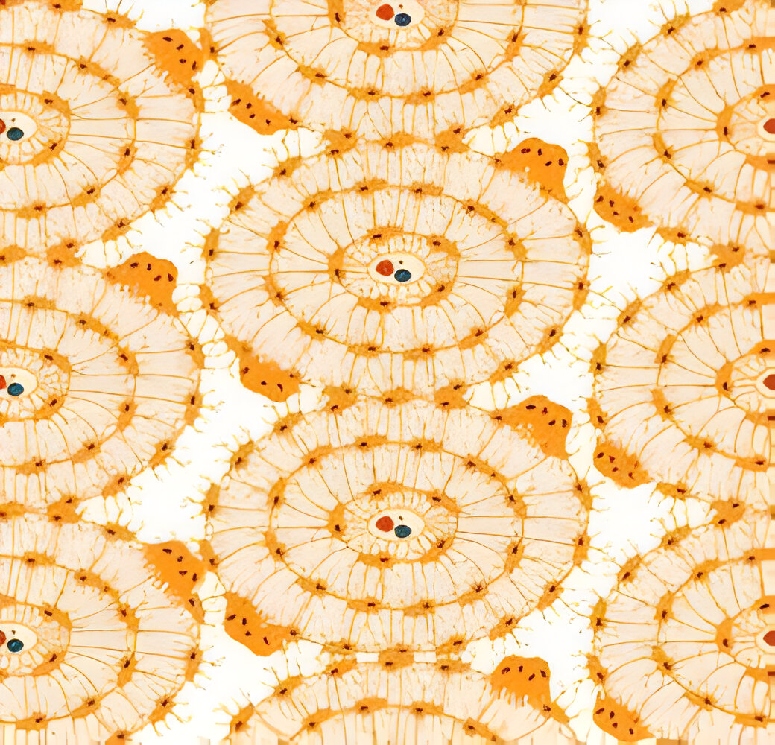

Slide 44
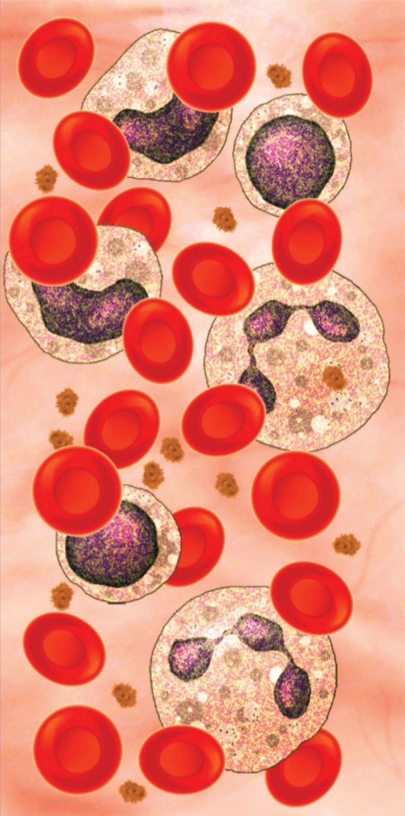
BLOOD
Fluid connective tissue

Slide 45
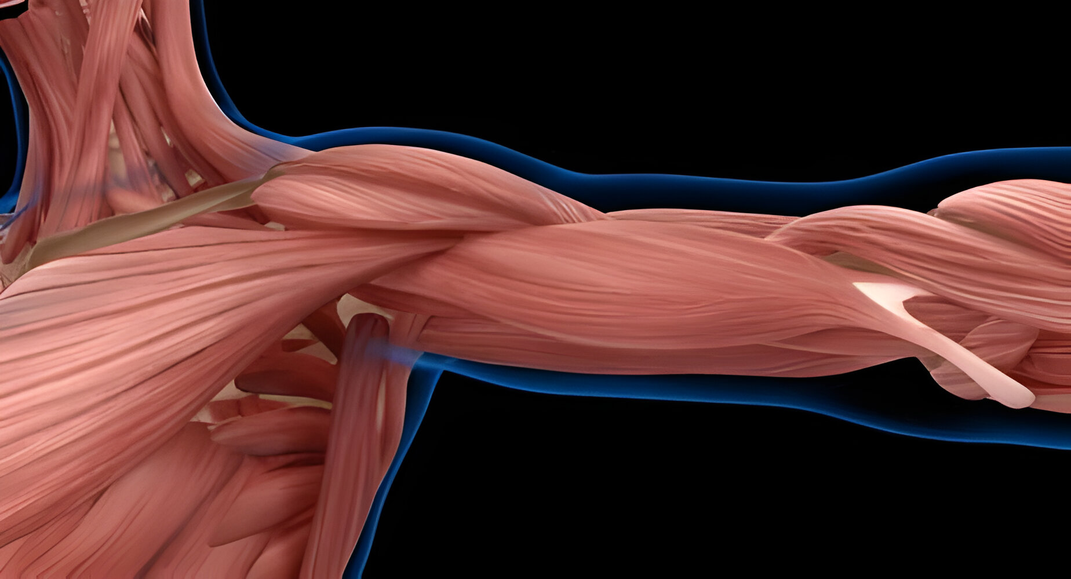
MUSCULAR TISSUE

Slide 46
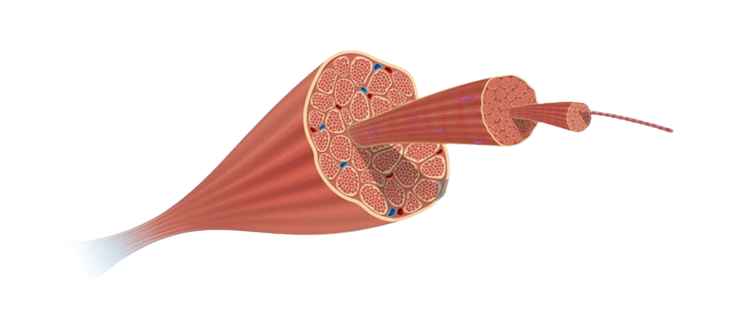

Slide 47
Their action causes the body or parts of the body to move in order to adjust to changes in the environment and maintain the positions of the various body parts.

Slide 48
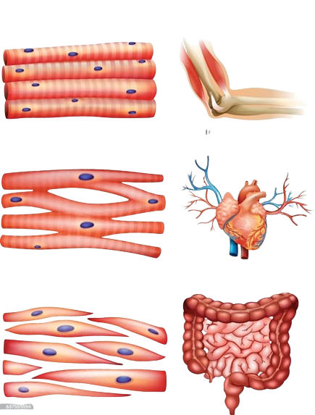
TYPES OF MUSCLE

Slide 49
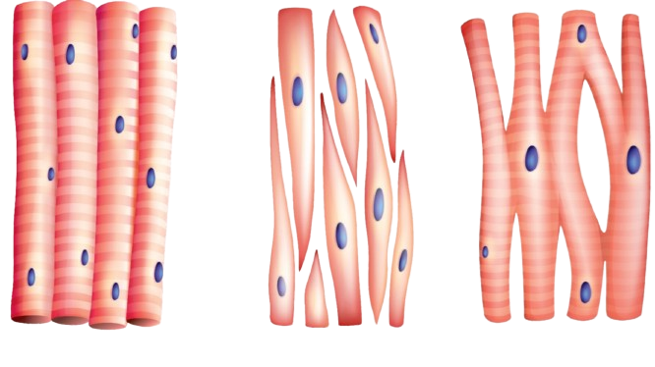
SKELETAL MUSCLE
Striated and bundled together in a parallel pattern.
Voluntary muscles because they are under conscious control
Multiple nuclei and are unbranched.

Slide 50
SMOOTH/VISCERAL MUSCLE
Tapered at both ends to form a spindle or fusiform shape.
Cell junctions hold them together, and they are encased in a connective tissue sheath.
Non striated
Involuntary muscles because their function is not controlled by the conscious mind.

Slide 51
CARDIAC MUSCLE
Cells can contract as a unit because of intercalated discs at some fusion points
They are branched and uninucleate.

Slide 52
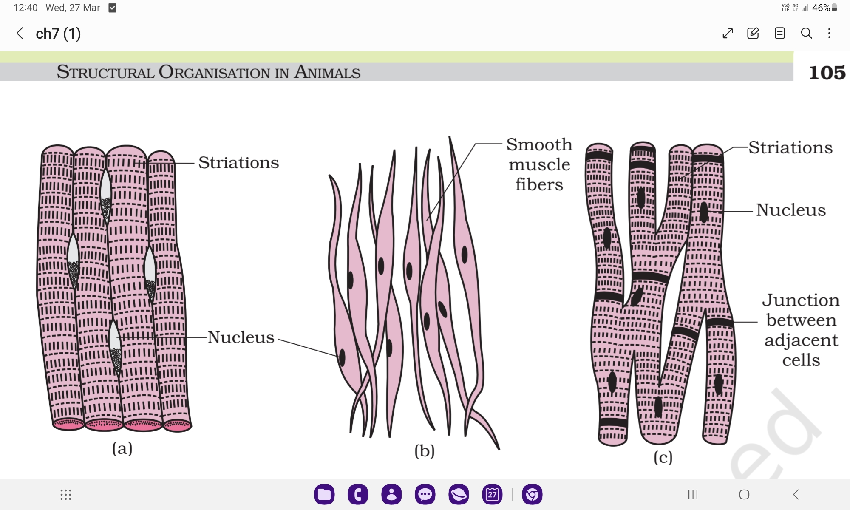

Slide 53
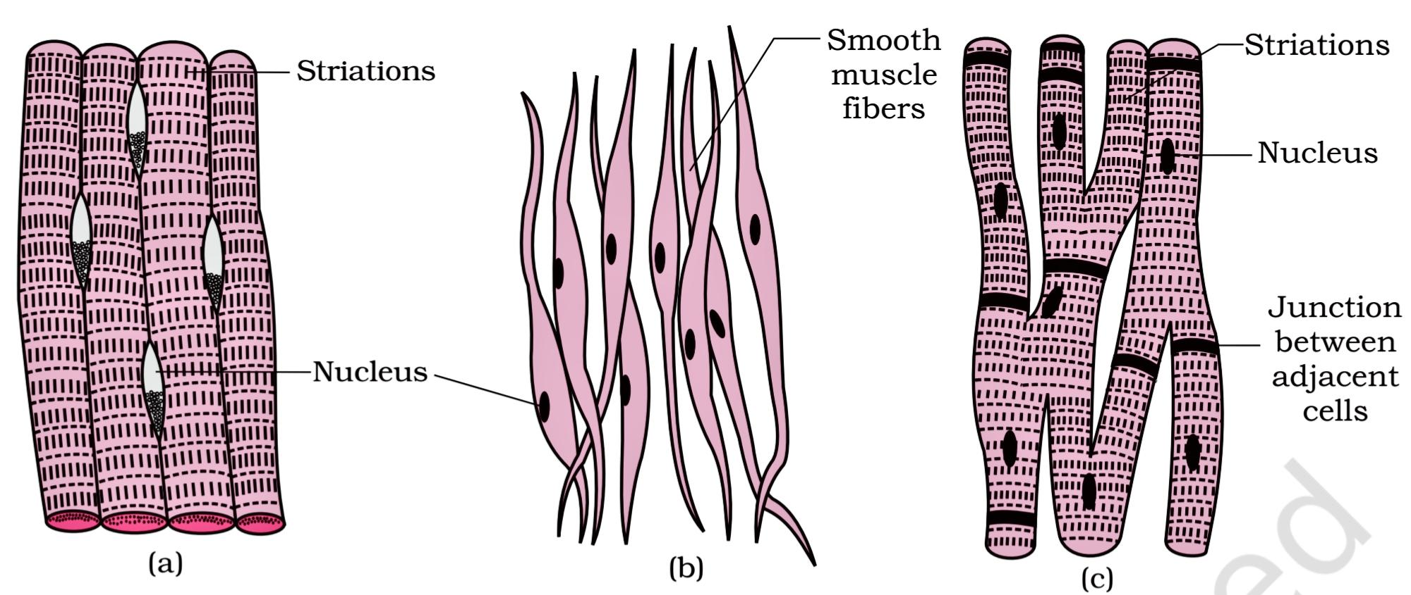

Slide 54
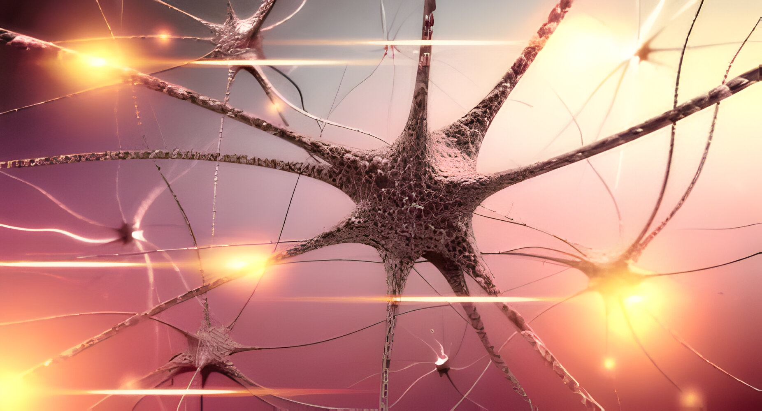
NEURAL TISSUE

Slide 55
Neural tissue is specialised for nerve impulse conduction
Unit - Neuron

Slide 56
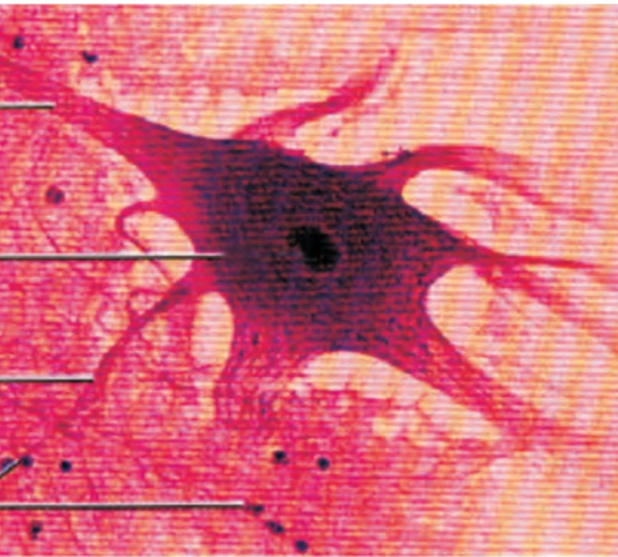
The neuron is made up of three parts: the cyton, the dendrites, and the axon.
Neuroglial cells guard and support neurons.

Slide 57

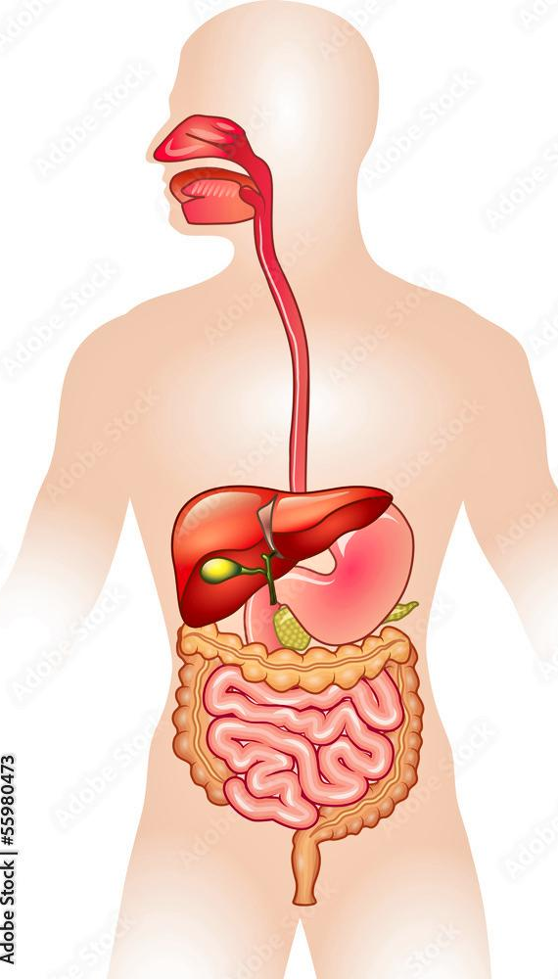
ORGAN AND ORGAN SYSTEM

Slide 58
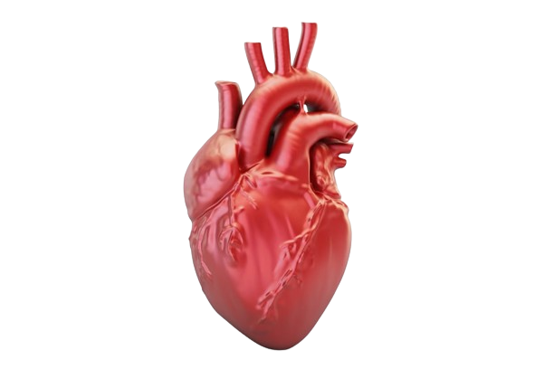
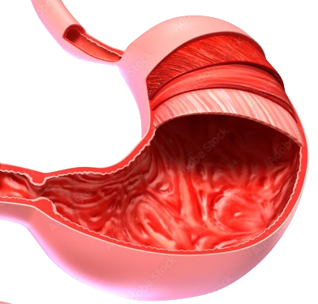
Basic tissue types organise in various ways to form organs

Slide 59
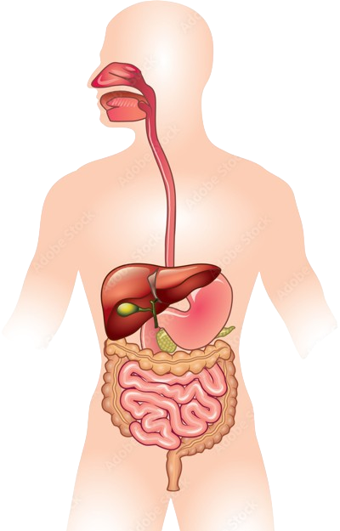
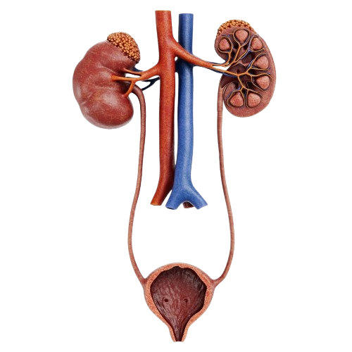
Group of organs associate with one another to form organ systems

Slide 60
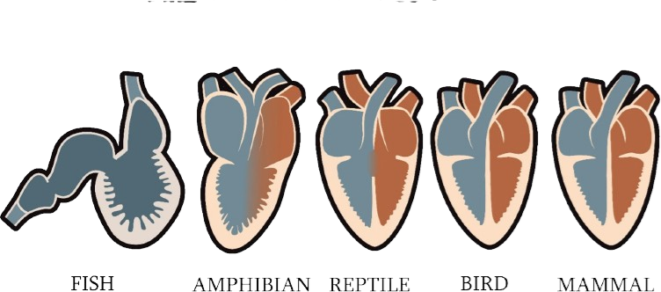

Slide 61
CLASS DISCUSSION
Select the false statement with respect to epithelial tissue.
1. It has a free surface
2. It faces body fluids sometimes
3. It faces the external environment sometimes
4. It sometimes forms middle structure part of organs
2. What is the function of neuroglial cells?
1. Formation of neurons
2. Destruction of neurons
3. Protection of neurons
4. Transmission of impulse along the neurons

Slide 62
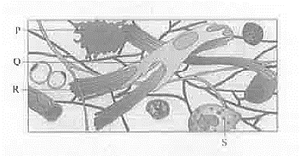
3. Diagram of areolar connective tissue is given. Identify the option with correct labeling:
1. P = Fibroblast, R = Collagen fibres
2. R = Collagen fibres, S = Macrophages
3. Q = Fibroblast, S = Mast cell
P = Macrophage, S = Fibroblast
4. Intercalated discs are present in-
1. Cardiac muscles 2. Striped muscles
3. Unstrained muscles 4. Ligament

Slide 63
5. Trapped dust particles are pushed out of respiratory tract by
1. Squamous epithelium 2. Glandular epithelium
Ciliated epithelium 4. Compound epithelium
6. Which one of the following contains the largest quantity of extracellular material: -
1. Straited muscle 2. Areolar tissue
Stratified epithelium 4. Myelinated nerve fibres
7. Excitable cells of neural tissue are
Microglial cells 2. Astrocytes
3. Schwann cells 4. Neurons

Slide 64
8. Fibroblast secretes: -
Matrix 2. Fibres 3. Both 1 and 2 4. Cells
9. Read the following (A-D) statements: -
A. connective tissue is most abundant and widely distributed in the body of complex animals
B. They are named connective tissues because of their special function of linking and supporting other tissues / organs of the body
C. They range from soft connective tissues to specialized types, which include cartilage, bone, adipose and blood
D. The cells of connective tissue secrete modified polysaccharides, which accumulate between cells and fibres and act as matrix
How many of the following statements are correct?
1. Four 2. Three 3. Two 4. One

Slide 65
10. Our heart consists of: -
(i) Epithelial tissue (ii) Connective tissue
(iii) Muscular tissue (iv) Neural tissue
Only ii 2. i & iii only 3. ii, iii & iv only 4. All of these
11. Read the characteristics of certain muscle fibres given below. Identify the muscle fibres: -
(I) Their functioning is not under the control of our will
(II) Associated with blood vessels, stomach and intestine
(III) Unnucleated cells
(IV) Muscle fibres that taper at both ends
1. Cardiac muscles fibres 2. Skeletal muscles fibres
3. Smooth muscles fibres 4. Both (1) & (3)

Slide 66
12. Cartilage is present in: -
1. Between adjacent bones of vertebral column and limb
2. In middle of the long bone
Both 4. None
13. Match the columns:
1. A – 2, B – 4, C – 3, D – 5 2. A – 1, B – 4, C – 3, D – 1
3. A – 4, B – 2, C – 3, D – 5 4. A – 4, B – 2, C – 1, D -3
 | Column A |  | Column B
A | Unicellular gland | 1 | Tight junctions
B | Fascilitation of transfer of ions | 2 | Gap junctions
C | Stopping of leakage of substance | 3 | Compound epithelia
D | Providing protection of underlying tissues | 4 | Goblet cell
 |  |  | Simple epithelia

Slide 67
14. If the main function is diffusion and movement of mucus, then ideal epithelia will be respectively-
Squamous, ciliated 2. Cuboidal, columnar
Squamous, brush-bordered 4. Cuboidal, brush-bordered
15. Which of the following pair is not having similar epithelia?
1. Blood vessels and alveoli 2. Stomach and intestine
3. Blood vessels and bronchioles 4. Stomach and PCT

Slide 68
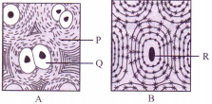
16. A and B are two specialized skeletal connective tissues. Identify them with correct labelling.
1. A – Cartilage, P – Elastic fibres
2. A – Bone, Q – Osteocyte
  3. B – Cartilage, R – Chondrocyte
  4. B – Bone, R -Harversian canal
17. Match the columns:
1. A – 1, B – 3, C – 2, D – 4 2. A – 1, B – 3, C – 4, D – 2
3. A – 3, B – 1, C – 2, D – 4 4. A – 1, B – 4, C – 3, D – 2
 | Column A |  | Column B
A | Adipose tissue | 1 | Below the skin
B | Dense regular tissues | 2 | In the skin
C | Dense irregular tissues | 3 | Tendons and ligaments
D | Specialized connective tissues | 4 | Cartilage, bones and blood

Slide 69
18. Which of the following is a wrongly matched pair?
Unicellular glandular cells – Goblet cell
Saliva – Exocrine secretion
Fusiform fibres – Smooth muscle 4. Cartilage – Areolar tissue
19. Consider the following statements.
I. All connective tissues except blood contain cells which secrete fibres of collagen or elastin
II. The matrix of connective tissues in formed by the modified polysaccharides
Select the correct option.
1. I is true, II is false 2. I is false, II is true
Both I and II are true 4. Both I and II are false

Slide 70
20. Statement I: The smooth muscle fibre taper at both ends (fusiform) and show striations
Statement II: Communication junction (intercalated discs) at some fusion points allow the cells to contract as a unit in cardiac muscle.
1. Both Statement I and Statement II are correct
2. Statement I is correct but Statement II is incorrect
3. Statement I is incorrect but Statement II is correct
4. Both Statement I and Statement II are incorrect

Slide 71
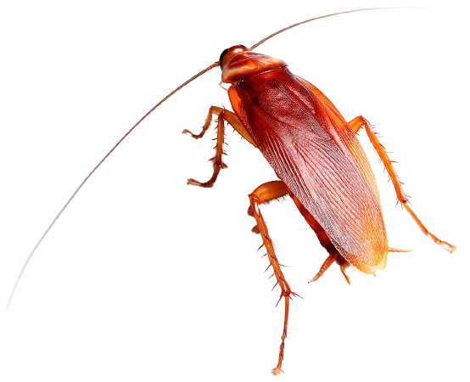
Taxonamical position
Phylum
Class
Genus
Species

Slide 72
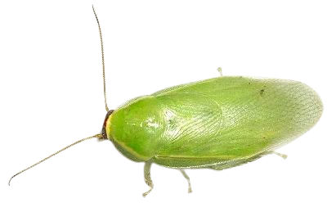

BASIC FEATURES
Colour :
Size :
Habit and habitat :
Distribution:

Slide 73

Morphology
Common cockroach in India: Periplaneta americana

Slide 74

BODY DIVISIONS

Slide 75

EXOSKELETON

Slide 76

HEAD

Slide 77

Mouth parts

Slide 78
Thorax
Prothorax
Mesothorax
Metathorax

Slide 79

3 PAIRS OF WALKING LEGS

Slide 80

2 Pairs of wings

Slide 81
Abdomen

Slide 82
FEMALE GENITAL POUCH

Slide 83
MALE GENITAL POUCH

Slide 84

ANAL STYLE AND ANAL CERCI

Slide 85


Slide 86
Anatomy

Slide 87

Digestive System:
Foregut
Midgut
Hindgut

Slide 89


Slide 90

Circulatory System: Open type
HAEMOCOEL
HAEMOLYMPH

Slide 91

Circulatory System: Open type
HEART

Slide 92

Respiratory System
TRACHIAL NETWORK

Slide 93

Respiratory System
TRACHIOLES AND DIFFUSSION OF GASES

Slide 94
Excretory System
URICOTELIC

Slide 95

Nervous System:

Slide 97

Sense organs
Eyes
Antennae
Labial palps
Maxilary palps
Anal cerci

Slide 98

Compound eyes

Slide 99
Antennae

Slide 100

Male reproductive system

Slide 101


Slide 102

Female Reproductive System

Slide 103


Slide 104

FERTILISATION AND DEVELEPMENT

Slide 105


Slide 106
VECTOR AND PEST

Slide 107

Class discussion
Wings extend beyond the abdomen in:
1. Male cockroach 2. Female cockroach
3. Queen bee 4. Drone
Which of the following figures shows the mandibles of cockroach?

Slide 108

3. In the given diagram, external features of cockroach are shown. Correctly identify the set of labelled parts.
1. 1-Antennae, 8-Hindwing, 10-Anal cerci
2. 3-Pronotum, 4-Metathroax, 7-Tegmina
3. 2-Compound eye, 3-Metathorax, 9-Abdomen
3-Pronotum, 5-Metathorax, 6-Tegmina
4. In the mount parts of a cockroach, the labium forms ____(i) ______ (ii) _______ acts as a tongue
1. (i)-Upper lip, (ii)-maxilla 2. (i)-upper lip, (ii)-hypopharynx
3. (i)-lower lip; (ii)-maxilla 4. (i)-lower lip; (ii)-hypopharynx

Slide 109
5. Dorsally placed sclerites in cockroach are termed as
Sternites 2. Tergites
Arthrodial membrane 4. Spiracles
6. Male cockroach differs from female cockroach in having
1. Antennae 2. Labarum 3. Maxillae 4. Anal styles
7. Which of the following features is not related to cockroach?
1. Body divisible into head, thorax and abdomen
2. Two pairs if wings are found
3. Three pairs of jointed legs are present on abdomen
Presence of annal cerci in both sexes
8. Choose the incorrect pair from the matches given below
1. Antennae - Sensory receptors
2. Metathoracic wings - Flying
3. Malpighian tubule - Excretion
4. Crop - Food grinding

Slide 110
9. Sclerites in cockroach are joined together by
1. Arthrodial membrane 2. Malpighian tubules
3. Ganglia 4. Phallomere
10. A pair of spermathecae is found in cockroach in
1. 2nd abdominal segment 2. 3rd abdominal segment
3. 6th abdominal segment 4. 8th abdominal segment
11. Capsule that the encloses the eggs in Periplaneta americana is known as:
1. Ootheca 2. Spermatophore
3. Egg capsule 4. Spiracle

Slide 111

In the given diagram of female reproductive system, which labelled organ performs the function of storage of sperms after copulation?
1. B 2. C 3. A 4. D

Slide 112
13. Read the given paragraph
“It is lined by glandular and ciliated cells. It absorbs nitrogenous waste products from haemocoel and convert them into uric acid which is excreted out though the hindgut”
Which of the following structures of cockroach is referred here?
Trachea 2. Hepatic caeca
Tergum 4. Malpighian tubule
14. Number of ommatidia in each compound eye of cockroach
500 2. 1000 3. 2000 4. 4000
15. Mouth parts of cockroach are of
1. Sponging type 2. Siphoning type
3. Chewing and lapping type 4. Biting and chewing type

Slide 113
16. Which of the following is correct for the common cockroach?
1. Malpighian tubules are excretory organs projecting out from the colon.
2. Oxygen is transported by haemoglobin in blood
3. Nitrogenous excretory product is urea
4. The food is grinded by mandibles and gizzard

Slide 114

FROG
Morphology and Anatomy

Slide 115

TAXONAMICAL POSITION
Kingdom: Animalia
Phylum: Chordata
Class: Amphibia
Genus: Rana
Species: Tigrina

Slide 116

Frogs are a type of amphibious vertebrate
Rana tigrina is the most common Indian species.
They are cold-blooded, also known as poikilotherms

Slide 117
Mimicry: An organism's protective coloration that blends with the environment
Aestivation: An organism's dormant state during the summer.
Hibernation: An organism's dormant state during the winter

Slide 118

MORPHOLOGY
Colour :
Skin :
Body divisions:

Slide 119

Head

Slide 120
Nictitating membrane: it is a whitish or translucent membrane that forms an inner eyelid.
Tympanum: A membranous structure that represents the ear, It is capable of receiving sound signals.

Slide 121
TRUNK
The forelimbs and hindlimbs aid in walking, swimming, leaping, and burrowing
The hind limbs are larger and more muscular than the forelimbs
Webbed digits on the feet aid in swimming.

Slide 122

Sexual Dimorphism
Male frogs are distinguished by the presence of sound-producing vocal sacs and a copulatory pad on the first forelimb digit.

Slide 123

ANATOMY

Slide 124
DIGESTIVE SYSTEM
It is made up of an alimentary canal as well as digestive glands.
Because frogs are carnivores, the alimentary canal is short,

Slide 125

The mouth opens into the buccal cavity, which leads to the oesophagus via the pharynx
Bilobed tongue: It aids in food capture

Slide 126


Slide 127
Stomach: This organ secretes gastric juice and HCl
Pancreas: Produces pancreatic juice containing digestive enzymes
Liver: Produces bile which is necessary for the digestion of fats.
Bile is temporarily stored in the gall bladder through the hepatic ducts.

Slide 128

The intestine is where the final digestion takes place.
The numerous villi and microvilli absorb digested food
Microvilli: These are the numerous finger-like projections that protrude from the intestine's inner wall.
Undigested solid waste enters the rectum and exits through the cloaca

Slide 129

Respiratory system
In water, they exhibit cutaneous respiration
Diffusion exchanges dissolved oxygen in water through the skin

Slide 130

In land Respiratory organs include the buccal cavity, skin, and lungs.
Respiration occurs through the skin during aestivation and hibernation.

Slide 131

Circulatory System:
circulatory system and a lymphatic system.
Lymph, lymph channels, and lymph nodes comprise the lymphatic system

Slide 132

BLOOD
Blood is made up of plasma and cells
RBC (red blood cells) or erythrocytes,
WBC (white blood cells) or leucocytes, and
Platelets

Slide 133


HEART

Slide 134
Blood vessels
The arteries (arterial system) transport blood from the heart to all parts of the body
The veins (venous system) collect blood from various parts of the body and transport it to the heart.

Slide 135
Hepatic portal system: A venous connection between the liver and the intestine

Slide 136
Renal portal system: A specialised venous connection that connects the kidney to the lower parts of the body.

Slide 137
Lymphtic system
Lymph, lymph channels, and lymph nodes comprise the lymphatic system.
Lymph is not the same as blood. It is devoid of RBCs and proteins.

Slide 138

Excretory System:
It is made up of two kidneys, ureters, a cloaca, and a urinary bladder.
Kidneys are red, bean-like structures found in the back of the body on either side of the vertebral column.

Slide 139
The nephron is the kidney&amp;apos;s structural and functional unit. There are numerous nephrons or uriniferous tubules in each kidney.
Ureotelic: Animals that excrete nitrogenous waste as urea.

Slide 140

Control and Co-ordination:
Endocrine glands: Secretory tissues that release various chemicals known as hormones, which cause chemical coordination in animals. Pituitary, thyroid, parathyroid, thymus, pineal body, pancreatic islets, adrenals, and gonads are the most important endocrine glands in frogs.

Slide 141
NERVOUS SYSTEM
C N S
BRAIN
SPINAL CORD
P N S
SPINAL NEVES
CRANIAL NERVES

Slide 142

BRAIN
Fore brain
Olfactory lobe
Cerebrum
Mid brain
Optic lobe
Hind brain
Diencephalone
Cerebellum
Medulla oblongata

Slide 143
Sense organs
Organs of sense: sensory papillae
Organs of taste: taste buds
Organs of smell: nasal epithelium
Organs of vision: eyes
Hearing organs: tympanum
Internal ears and eyes are well-organised structures.

Slide 144

Reproduction
The male reproductive system consists of a pair of yellowish ovoid testes.
attach to the upper part of the kidney via the mesorchium, a double fold of the peritoneum.

Slide 145
Vasa efferentia: They are 10-12 in number and originate in the testes.
Bidder's canal: Bidder's canal is found inside the kidney of a frog. It receives sperm from the testes via several vasa efferentia.

Slide 146

Female Reproductive System: It is made up of two ovaries located near the kidneys
The ovaries and the kidneys have no functional relationship

Slide 147

A mature female can lay between 2500 and 3000 eggs at a time.
Fertilisation is external and takes place in water

Slide 148

The frog life cycle exhibits complete metamorphosis, which includes a larval stage.

Slide 149

Frogs are beneficial to humans because they eat insects and protect crops. Frogs maintain ecological balance in the ecosystem because they serve as an important link in the food chain and food web

Slide 150
CLASS DISCUSSION
1. Bidder’s canal in frog is found in:
1. Kidney 2. Testes 3. Urinary bladder 4. Cloaca
2. Dorsal part of frog is …… and ventral part is ….
1. Olive green, uniformly pale yellow
2. Olive green, uniformly dark yellow
3. Olive green, nonuniformly pale yellow
Olive green, nonuniformly dark yellow
3. Which of the following found in frog: -
1. Five fingers and four toes 2. Four fingers and five toes
3. Five fingers and five toes 4. Four fingers and four toes

Slide 151
4. Fertilization in frog
1. Internal and takes place in oviduct
2. External and takes place in water
3. Internal and takes place in water
Either external or internal
5. In frog during aestivation and hibernation gaseous exchange takes place through
Lungs 2. Skin 3. Gills 4. Buccal cavity
6. In frog, excess of the bile juice secreted by the liver is stored in
Intestine 2. Pancreas 3. Gall bladder 4. Rectum
7. In frog, undigested solid waste passes out through
1. Rectum 2. Cloaca 3. Anus 4. Intestine

Slide 152
8. The skin of frog is slippery and smooth due to the presence of
Mucus 2. Gelatin 3. Waxy skin 4. Mucilage
9. Which is the triangular structure associated with heart of frog present on dorsal side and receives the blood through major veins called vena cava?
1. Conus arteriosus 2. Sinus venosus
3. Right atrium 4. Ventricle
10. Which of the following is mismatched w.r.t Rana tigrina?
1. Hepatic portal system: Special venous connection between liver and intestine
2. Renal portal system: Special venous connection between kidneys and lower parts of the body
3. RBCs: Oval and nucleated
4. Lymph: Has proteins and RBCs

Slide 153
11. Which of the following option is incorrect?
1. Frogs exhibit sexual dimorphism
2. Male frog can be distinguished by the presence of sound producing vocal sacs
3. Frogs are herbivores
In frog, liver secretes bile that is stored in gall bladder
12. The length of the alimentary canal in frog is
1. Long because frogs are herbivorous
2. Short because frogs are herbivorous
3. Long because frogs are carnivorous
Short because frogs are carnivorous

Slide 154
13. In male reproductive the system of frog ……A….. are 10-12 in number that arises from the testes. They enter the …..B…. on their sides and opens into ….C……
Identify A to C to complete the given statement
1. Fat bodies, kidney, adrenal gland
2. Mesorchium, adrenal gland, urinary bladder
3. Vesa efferentia, kidney, bidder’s canal
Vesa efferentia, kidney, urinogenital duct
14. Select the correct route for the passage of sperms in male frogs:
1. Testes → Vesa efferentia → Kidney → Seminal Vesicle → Urinogenital duct → Cloaca
2. Testes → Vesa efferentia → Bidder’s canal → Ureter → Cloaca
3. Testes → Vesa efferentia → Kidney → Bidder’s canal → Urinogenital duct → Cloaca
4. Testes → Bidder’s canal → Kidney → Vesa efferentia → Urinogenital duct → Cloaca

Slide 155
15. Which of the following statements is not true?
1. The body colour offers its protective coloration
2. Summer sleep of frog is called aestivation
3. Tail is present in the lifecycle of frog
4. Mouth is bounded by a pair of lips

